Slide 1
William Stallings Computer Organization and Architecture
7th Edition
Chapter 7 Input/Output

Slide 2
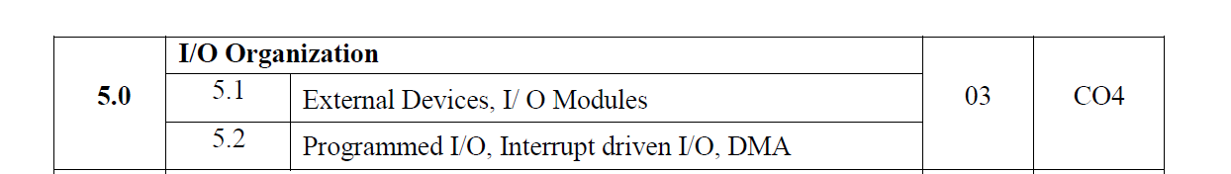

Slide 3
Input/Output Problems
I/O module stands for Input/Output module, which is a device that acts as the connective bridge between a computer system at one end and an I/O or peripheral device of some kind at the other, such as a printer, webcam or scanner.
I/O module contains logic for performing a communication function between the peripheral and the bus
Peripherals not connected directly to bus because
Wide variety of peripherals
—Delivering different amounts of data
—At different speeds
—In different formats
All slower than CPU and RAM
Peripherals use different data formats and address length
Need I/O modules

Slide 4
Main Functions of Input/Output Module
Interface to CPU and Memory
Interface to one or more peripherals

Slide 5
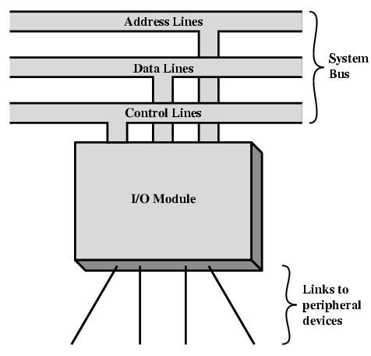
Generic Model of I/O Module

Slide 6
I/O Module Functions
Control and timing-status reporting, commands and information transfer.
Processor communication-decoding and accepting commands, reporting status updates and recognizing its own address.
Device communication-status reporting, commands and information transfer.
Data buffering-manage the transfer speed between the memory, processor and other peripheral devices that are connected.
Error detection-data-based issues during transmission.

Slide 7
External Devices
Human readable-human
—Screen, printer, keyboard
Machine readable-equipment
—magnetic disk and tape systems- Monitoring and control
Communication-remote devices
—human-readable device, such as a terminal, a machine-readable
device, or even another computer
—Network Interface Card (NIC-connects to N/w)

Slide 8
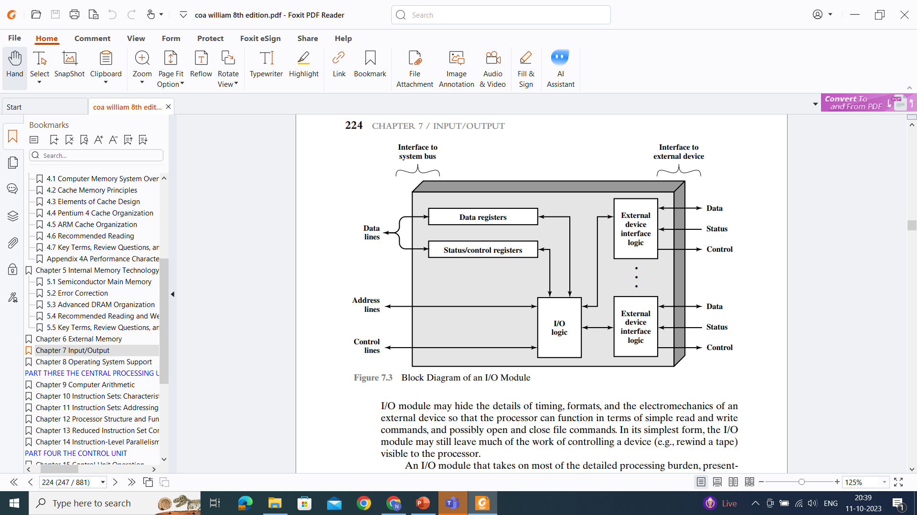

Slide 9
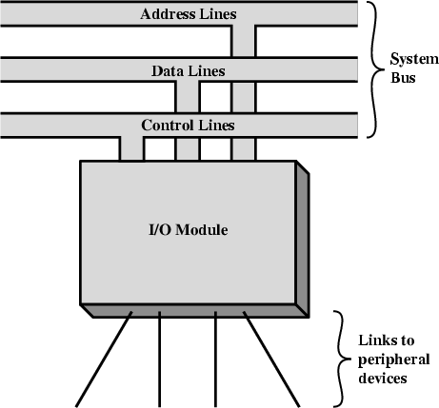
The control of the transfer of data from an external device to the processor might involve the following sequence of steps: I/O Steps
CPU checks I/O module device status
I/O module returns status
If device is ready, CPU requests data transfer
I/O module gets data from device
I/O module transfers data to CPU
Variations for output, DMA, etc.

Slide 10
Input Output Techniques
Programmed
Interrupt driven
Direct Memory Access (DMA)

Slide 11
Programmed-data are exchanged between the processor and the I/O module.
The processor executes a program that gives it direct control of the I/O operation
When the processor issues a command to the I/O module, it must wait until the I/O operation is complete
With interrupt-driven I/O, the processor issues an I/O command, continues to execute other instructions, and is interrupted by the I/O module when the latter has completed its work.
DMA-I/O module and main memory exchange data directly, without processorinvolvement.

Slide 12
PROGRAMMED I/O
Data transfer operations are completely controlled by CPU i.e. CPU
executes a program that
initiates,
directs and
terminates the I/O operation

Slide 13
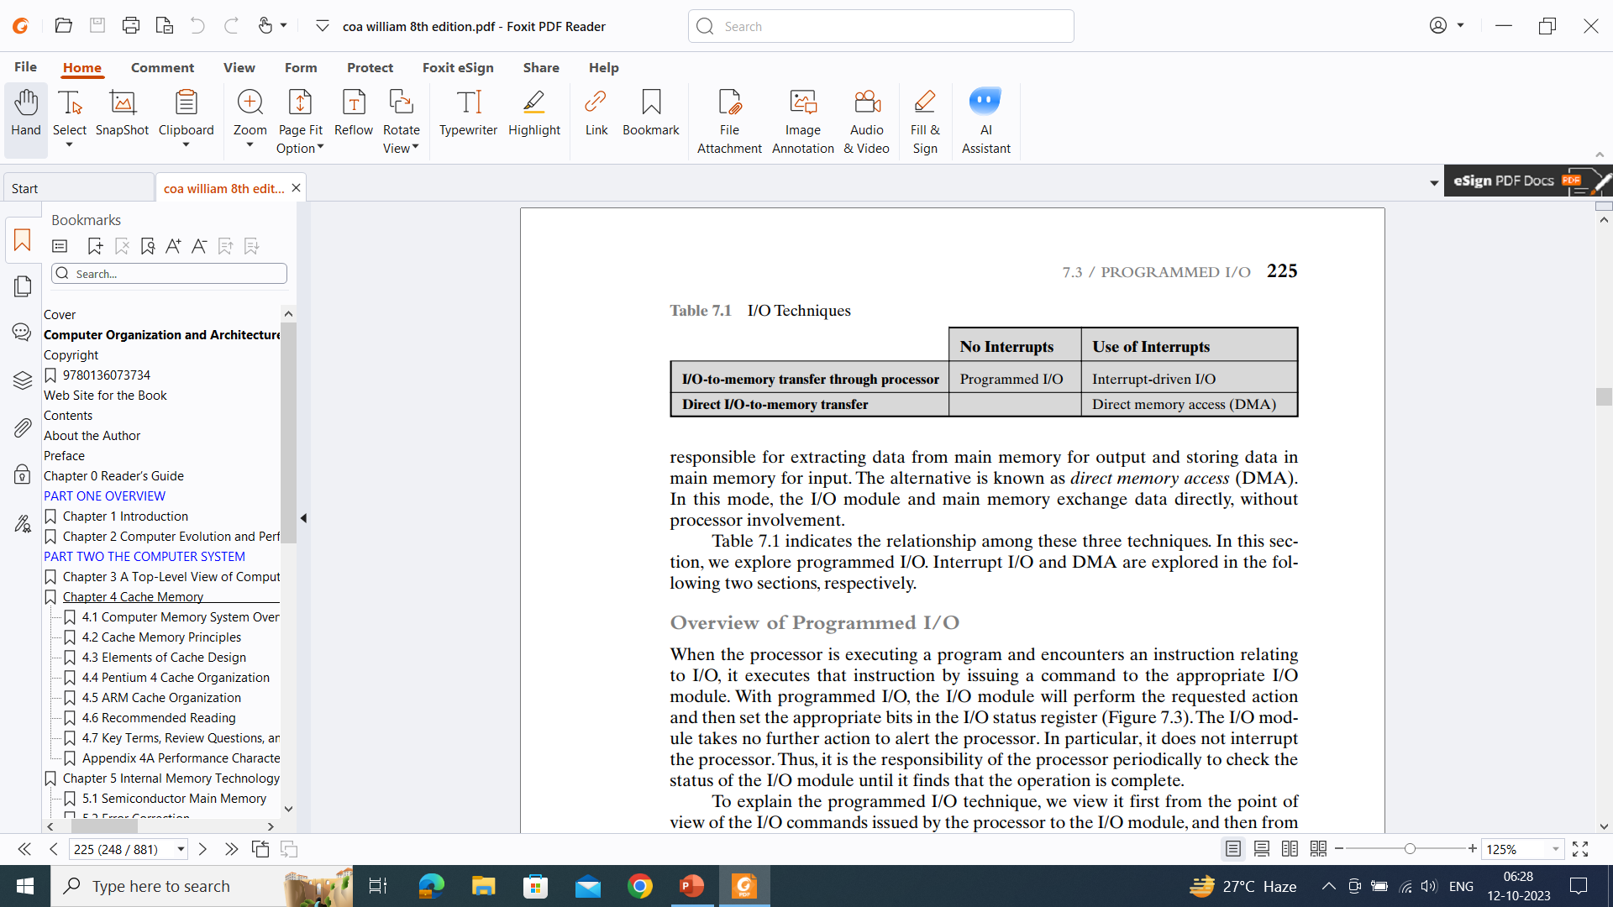

Slide 14
Overview of Programmed I/O
When the processor is executing a program and encounters an instruction relating to I/O, it executes that instruction by issuing a command to the appropriate I/O module.
With programmed I/O, the I/O module will perform the requested action and then set the appropriate bits in the I/O status register
Processor periodically checks the status of the I/O module until it finds that the operation is complete

Slide 15
I/O Commands
Processor issues an address, specifying the particular I/O module and external device, and an I/O command to execute an I/O-related instruction
Control: Used to activate a peripheral and tell it what to do.
Test: Used to test various status conditions associated with an I/O module and its peripherals.
Read: Causes the I/O module to obtain an item of data from the peripheral and place it in an internal buffer
Write: Causes the I/O module to take an item of data (byte or word) from the
data bus and subsequently transmit that data item to the peripheral.

Slide 16
PROGRAMMED I/O
Useful where h/w costs need to be minimized.
Entire I/O is handled by CPU
STEPS
—1. Read I/O devices status bit
—2. Test status bit to determine if device is ready
—3. If device not ready return to step 1
—4. During interval when device is not ready CPU simply wastes its time until device is ready

Slide 17
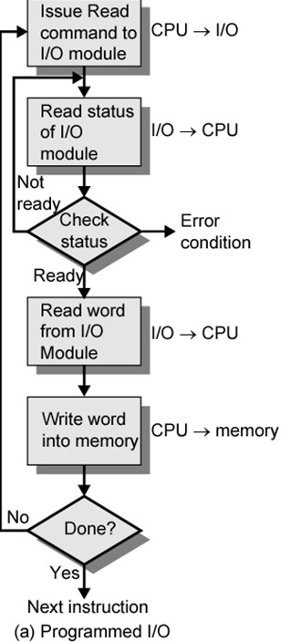

Slide 18
Figure-use of programmed I/O to read in a block of data from a peripheral device (e.g., a record from tape) into memory.
Data are read in one word (e.g., 16 bits) at a time.
For each word that is read in, the processor must remain in a status-checking cycle until it determines that the word is available in the I/O module’s data register.
When the processor issues an I/O command, the command contains the address of the desired device.
Thus, each I/O module must interpret the address lines to determine if the command is for itself

Slide 19
When the processor, main memory, and I/O share a common bus, two modes of addressing are possible: memory mapped and isolated.
With memory-mapped I/O, there is a single address space for memory locations and I/O devices.
the address space for I/O is isolated from that for memory, this is referred to as isolated I/O.

Slide 20
Programmed I/O
CPU has direct control over I/O
—Sensing status
—Read/write commands
—Transferring data
CPU waits for I/O module to complete operation
Wastes CPU time

Slide 21
Programmed I/O - detail
CPU requests I/O operation
I/O module performs operation
I/O module sets status bits
CPU checks status bits periodically
I/O module does not inform CPU directly
I/O module does not interrupt CPU
CPU may wait or come back later

Slide 22
INTERRUPT DRIVEN I/O
Major drawback of programmed I/O is busy waiting
Speed of I/O devices is much slower than CPU
Performance of CPU goes down as it has to repeatedly check for device status
Solution: Switch to another task if device is not ready and thus use interrupt mechanism
CPU issues an I/O command to a module and then go on to do some other useful work.
The I/O module will then interrupt the processor to request service when it is ready to exchange data with the processor.
The processor then executes the data transfer, as before, and then resumes its former processing.

Slide 23
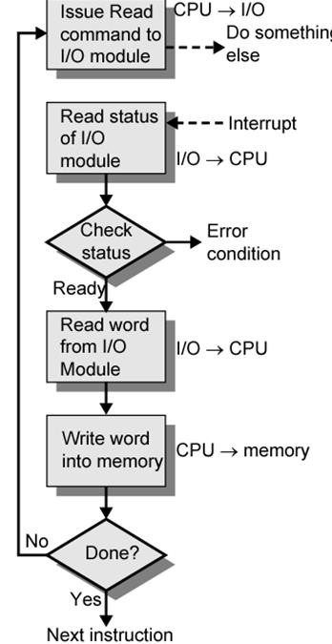

Slide 24
From I/O module’s point
I/O module receives a READ command from the processor for input
The I/O module then proceeds to read data in from an associated peripheral.
Once the data are in the module’s data register, the module signals an interrupt to the processor over a control line.
The module then waits until its data are requested by the processor.
When the request is made, the module places its data on the data bus and is then ready for another I/O operation.

Slide 25
From CPU point
The processor issues a READ command.
It then goes off and does something else
At the end of each instruction cycle, the processor checks for interrupts
When the interrupt from the I/O module occurs, the processor saves the context (e.g., program counter and processor registers) of the current program and processes the interrupt.
In this case, the processor reads the word of data from the I/O module and stores it in memory.
It then restores the context of the program it was working on (or some other program) and resumes execution.

Slide 26
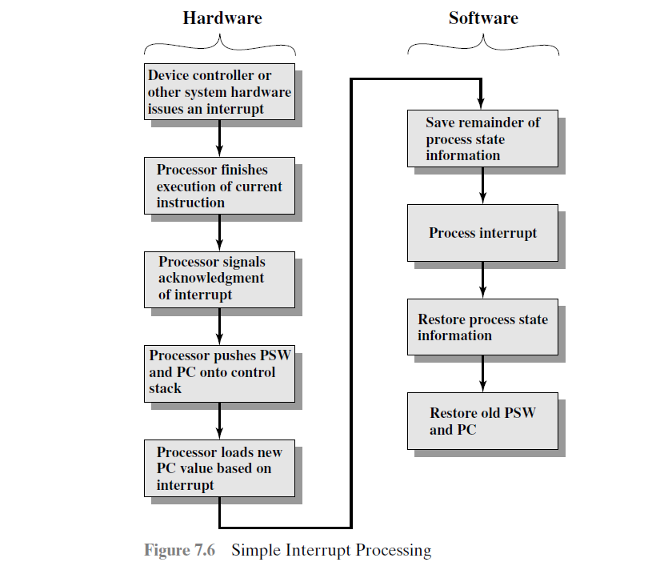
Interrupt Processing-Occurrence of interrupt-H/W & s/w
it is important to save all the state information about the interrupted
program for later resumption

Slide 27
Interrupt Driven I/O
Overcomes CPU waiting-Interrupt I/O is more efficient
No repeated CPU checking of device
I/O module interrupts when ready
interrupt I/O still consumes a lot of processor time, (because every word of data that goes from memory to I/O module/or from I/O module to memory must pass through the processor)

Slide 28
Interrupt Driven I/O Basic Operation
CPU issues read command
I/O module gets data from peripheral whilst CPU does other work
I/O module interrupts CPU
CPU requests data
I/O module transfers data

Slide 29
CPU Viewpoint
Issue read command
Do other work
Check for interrupt at end of each instruction cycle
If interrupted:-
—Save context (registers)
—Process interrupt
– Fetch data & store

Slide 30
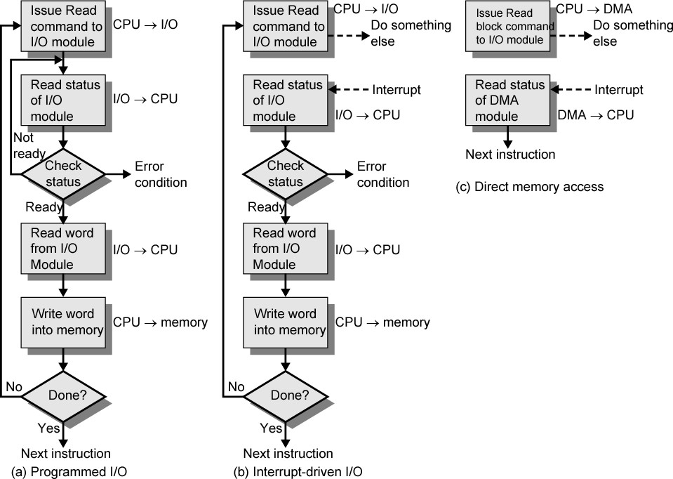
Three Techniques for Input of a Block of Data

Slide 31
Direct Memory Access
Interrupt driven and programmed I/O require active CPU intervention
—Transfer rate is limited (with which the processor can test
and service a device.)
—CPU is tied up (managing an I/O transfer)
large volumes of data are to be moved-DMA
Direct memory access (DMA) is a feature of computer systems that allows certain hardware subsystems to access main system memory (RAM) independently of the central processing unit (CPU).

Slide 32
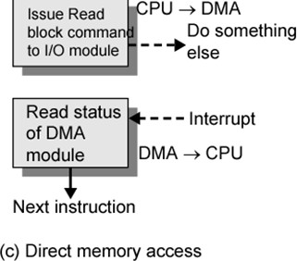
DMA Function
Involves Additional Module (hardware) on bus
DMA controller takes over from CPU for I/O

Slide 33
The DMA module is capable of mimicking the processor-transfer data to and from memory over the system bus.
DMA module must use the bus only when the processor does not need it, or it must force the processor to suspend operation temporarily-more common and is referred to as cycle stealing, because the DMA module in effect steals a bus cycle.

Slide 34
DMA Operation
CPU tells DMA controller:-
Read/Write request is made using control line
Device address communicated on data lines
Starting address of memory block communicated in data line & stored by DMA
Amount of data to be transferred communicated in data line &stored in data count register
CPU carries on with other work
DMA controller deals with transfer
DMA controller sends interrupt when finished
Processor involvement only at start & end of transfer

Slide 35
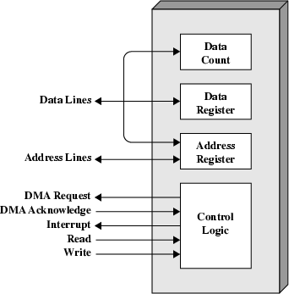
Typical DMA Module Diagram

Slide 36
DMA data transfer modes:
Burst Mode
Cycle Stealing Mode
Transparent Mode

Slide 37
DMA data transfer modes
DMA block transfer/Burst Mode
A block of data of arbitrary length is transferred in a single
Burst
Burst - Temporary high-speed data transmission mode used to facilitate sequential data transfer at maximum throughput.

Slide 38
2. Cycle stealing mode
DMA controller is allowed to use system bus to transfer one
word of data at a time, after which it must return control of the bus to the CPU.
The DMA module uses the system bus only when the processor does not need it, or it must force the processor to suspend operation temporarily.
Referred to as cycle stealing, because the DMA module in effect steals a bus cycle.

Slide 39
DMA data transfer modes:
3.Transparent DMA
DMA is allowed to steal only those cycles when CPU is not using system bus

Slide 40
Advantages of DMA
High transfer rates
fewer CPU cycles for each transfer.
DMA speedups the memory operations by bypassing the involvement of the CPU.
Work overload on the CPU decreases.

Slide 41
Disadvantages of DMA
DMA transfer requires a DMA controller to carry out
the operation
More expensive system
Synchronization mechanisms must be provided in order to avoid accessing non-updated information from RAM
Cache coherence problem (Cache and the main memory may have inconsistent copies of the same object.)

